Slide 1
Biol 111 Discussion 3 9-25-13
View to a Cell
Science News
June 15, 2013

Slide 2
Before we start….?
See content lecture 11. Master for Friday
Any questions regarding exam? Please see me if you think your scantron was not scanned properly. All scantrons were scanned and saved as images.

Slide 3
Today’s paper included ½ page of reading and 26 pictures! Like the good old days of picture books!
Let’s start with some basic concepts of optics and microscopy.

Slide 4
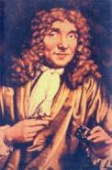
Cells and Microscopes
Who made the first microscope?
Anton van Leeuvenhoek
There is is…

Slide 5
1657
Leeuwnhoek is thought to have been the first to see and describe live microorganisms. (From his own mouth!) He called these “animacules”
He observed every type of microorganism except viruses.

Slide 6
What do microscopes do?
Magnify
3X

Slide 7
Magnification is worthless without resolution.
Define resolution?

Slide 9
The smaller this distance can be, the better the resolving power of a microscope or imaging system

Slide 11
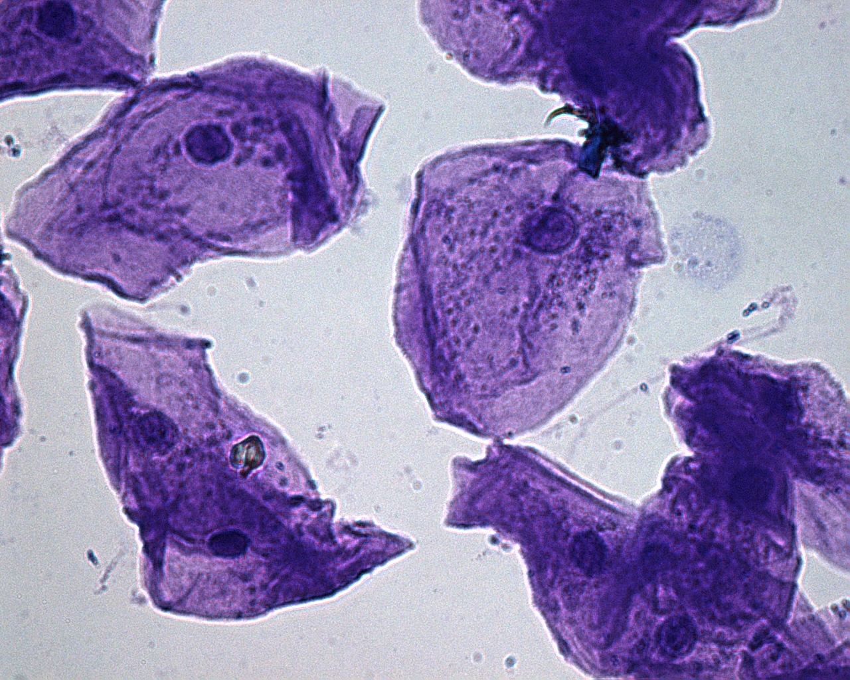
For humans to see something it must also “stick out” from its surroundings.
Simple dyes can be used to provide contrast from background or
to stains specific structures.

Slide 12
Imaging
The art of providing resolution and color/contrast to see something clearly is called imaging.
Your paper provides some AMAZING examples of the newest types of cell imaging.

Slide 13
Any guesses?...

Slide 14
Older imaging of mitosis

Slide 15
Compare resolution! Go to paper

Slide 16
Slideshow
http://www.sciencenews.org/view/feature/id/350693/description/View_to_a_cell
Use the slideshow to learn/review cell parts and their functions!

Slide 18
How are the colors made?
All of the vibrant colors in these pictures come from florescent molecules. In a sense the cells and cell parts are “stained” with fluorescent dyes.
How do the dyes stick to specific parts?

Slide 19
Antibodies!
Nearly every picture shows the use of a specific antibody that binds to a specific molecule that would only be found in/on specific cell parts.
Antibodies are VERY specific for one part of one type of molecule. They are used in all types of imaging to show the location of a specific substance (which is called the antigen).

Slide 20
YOU make antibodies that bind antigens from pathogens (bacteria, viruses, fungi etc., that can make you sick)

Slide 21
In research and medicine, those same types of antibodies are used for imaging. The reason they show up and look so beautiful, is that a fluorescent molecule is attached to the antibody. So the antibody binds the antigen and we see beautiful color.

